Slide 1
Spatial Systems

Slide 2
Types of Spatial Data Structures
Split into two types of structures
  Spatial Partition Hierarchies (SPHs)‏
    BSPs, Octrees, KDTrees and other variants
  Bounding Volume Hierarchies (BVHs)‏
    Sphere trees, AABB trees, k-DOP trees
SPHs organize space by partitioning
  Space based
BVHs organize a scene by enclosing geometry
  Geometry based

Slide 3
Spatial System
A spatial system is something that organizes space and the objects inside
Allows the user quick queries on what is in a defined area
  Be it a frustum, sphere, AABB or some bounding volume
Used for rendering, collision, AI…

Slide 4
Spatial Data Structure (SDS)‏
Organizes geometry in some
n-dimensional space
Typically found as a hierarchy
Also these structures are expensive to generate
  Should be done as a pre-process step

Slide 5
Tree Structure Review
A tree is similar to a linked list.
Instead of a head pointer for the list, we have a root node for a tree.
Each node in the tree has multiple next pointers.
In a binary tree each node will have 2 next pointers, commonly referred to as right and left.

Slide 6
Trees continued
The tree implementation we will create will be more generic, supporting any number of children.
The Three types of nodes we will be concerned with are root, internal and leaf.
An internal node is any with children.
A leaf node is one without children. We may need to add specific code to leaf nodes, as they will typically be the only ones with data stored.

Slide 7
Spatial Partitioning Tree
We want to be able to create one tree structure that will support any spatial partitioning.
Our tree will need to support building the tree, calling a split method on data, and traversing the tree.
A typical spatial partitioning tree would need to handle serialization as well.
These methods will have to be handled in a generic manner so that the tree can be used to implement drastically different Spatial Systems.

Slide 8
SpatialTree implementation
SpatialTree is the name of our generic tree implementation
ED_SpatialTree is the base tree class. We will inherit from it to allow specialized tree creation, usually just the root node.
ED_SpatialTreeNode is our basic node type. ED_SpatialTreeInternalNode and ED_SpatialTreeLeafNode will both be specializations of this class. We will typically only need to specialize the internal node class to implement specific uses.

Slide 9
SpatialTree Implementation
Only Leaf nodes will store an ED_SpatialTreeData object.
ED_SpatialTreeData is an abstract class.
It declares prototypes for Split and IsSplittable methods. These methods will need to be specialized in data classes inheriting from this class.
The Split method will handle filling out a list of data objects based on splitting the current data object.
IsSplittable will simply return true if the data object should or could be split. This will define your stopping condition when building a tree.

Slide 10
SpatialTree generation summary
Build data for the node.
Split the node if it is splitable.
Repeat for all data created by the split.
Our implementation will use a recursive depth first build and traverse. Breadth first methods are common as well.

Slide 11
KDTrees

Slide 12
KDTree
KDTrees are a Spatial Partitioning Hierarchy used to organize space into ‘K’ dimensions.
In our implementation K will be 3, but this is not a requirement to use a KDTree in 3D. We could do a 2D-Tree or a 4D-Tree in a 3D rendering system.
A KDTree is a binary tree. Each Internal Node will be split producing data for two children.

Slide 13
KDTree Data
The data to be stored for a KDTree will be what axis this node will be split on and the value or distance of the split.
The split axis and split value define a plane.
The normal of the plane is either the x, y or z axis and the distance of the plane will be stored in the split value.

Slide 14
KDTree Data Splitting
To Split a KDTree data object, we will create 2 spaces defined by what side of the splitting plane they are on.
Each split we will iterate to the next split axis, x, then y, then z, then x, y, z…
There are various ways to decide what the splitting value should be. For our implementation we just split the parent’s space in half.
These splits will define AABBs.

Slide 15
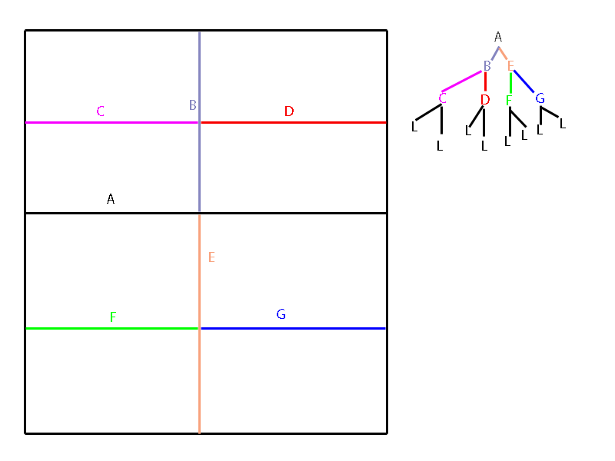
KDTree programmer art
The orange book has another image for k-d trees on page 320

Slide 16
KDTree Traversal
To traverse a KDTree we will need to decide where the bounds of our object lie in relation to the current node’s splitting plane.
If our object straddles the plane, we traverse both children.
If the bounds lie on the left or right we only traverse the left or right child.
If the node is a leaf, we stop. In our implementation we are rendering the leaf node AABBs. We would commonly use the leaf data to define collision routines, checking collision against objects in the same leaf.

Slide 17
Bounding Volume Hierarchies

Slide 18
Bounding Volumes
Bounding Volumes (BVs) enclose a set of objects
  Points, Triangles, other BVs
Idea here is to create a geometric shape that is simpler than the shape it encloses
  Spheres, AABBs, k-DOPs…

Slide 19
Bounding Volume Hierarchy
BVHs consists of different “types” of nodes
  A root, being the top node with no parents
  A leaf being the node with no kids and stores the actual geometry
  Everything else is an internal node
Every node has a BV that encloses all the geometry in its sub-tree
  Therefore, the root’s BV encloses all the geometry in the scene

Slide 20
Hierarchical View Frustum Culling

Slide 21
Culling using BVHs
With BVHs we can increase performance by doing a preorder traversal to do the culling
Start at the root node and for every iteration of the traversal, test the BV against the frustum

Slide 22
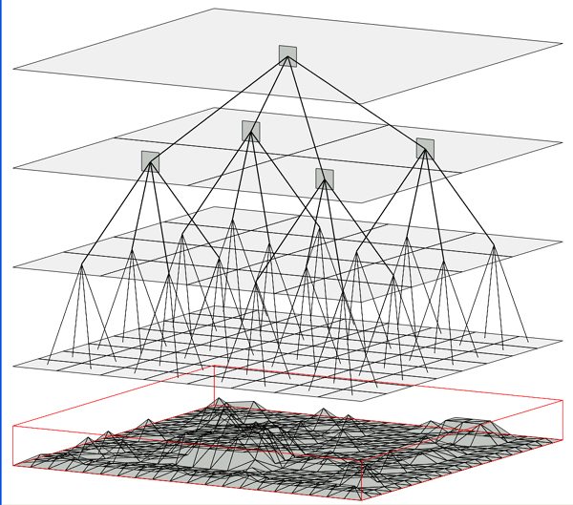

Slide 23
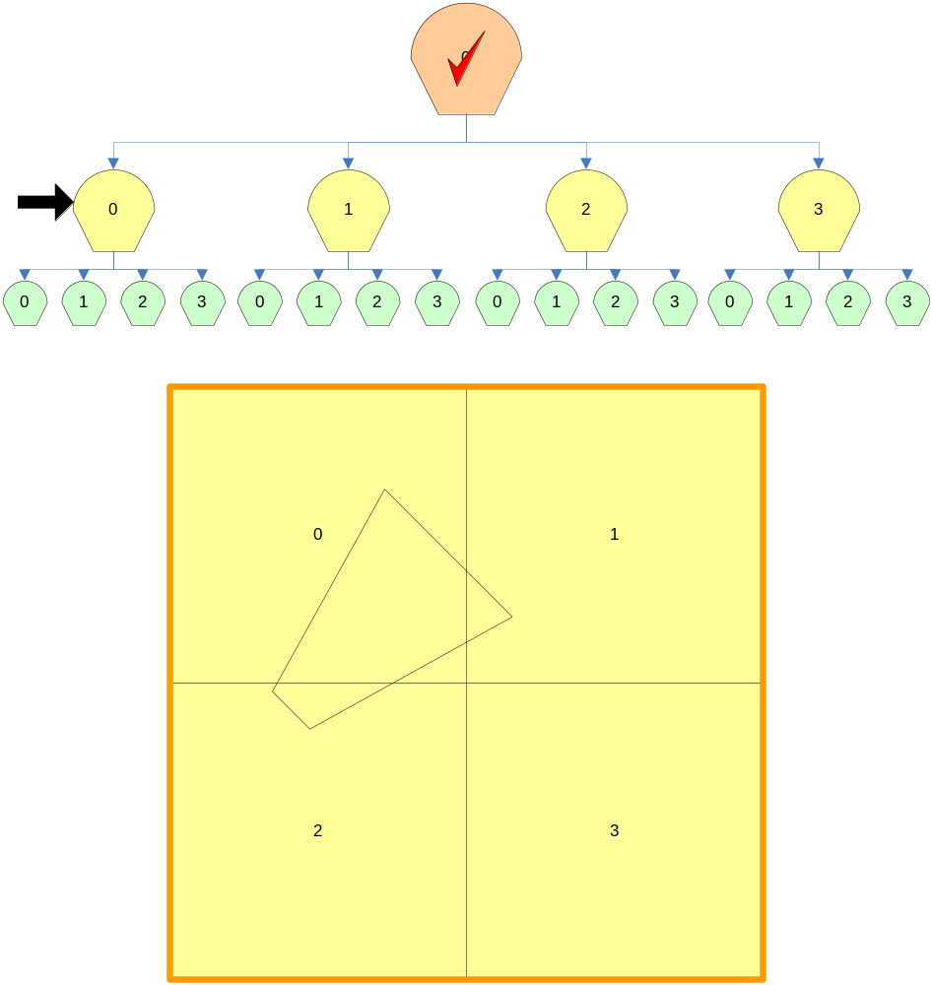
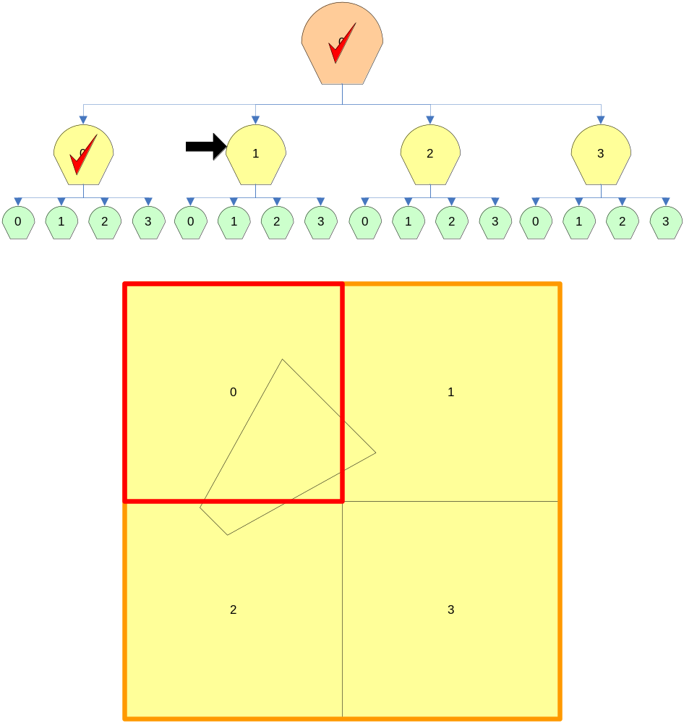
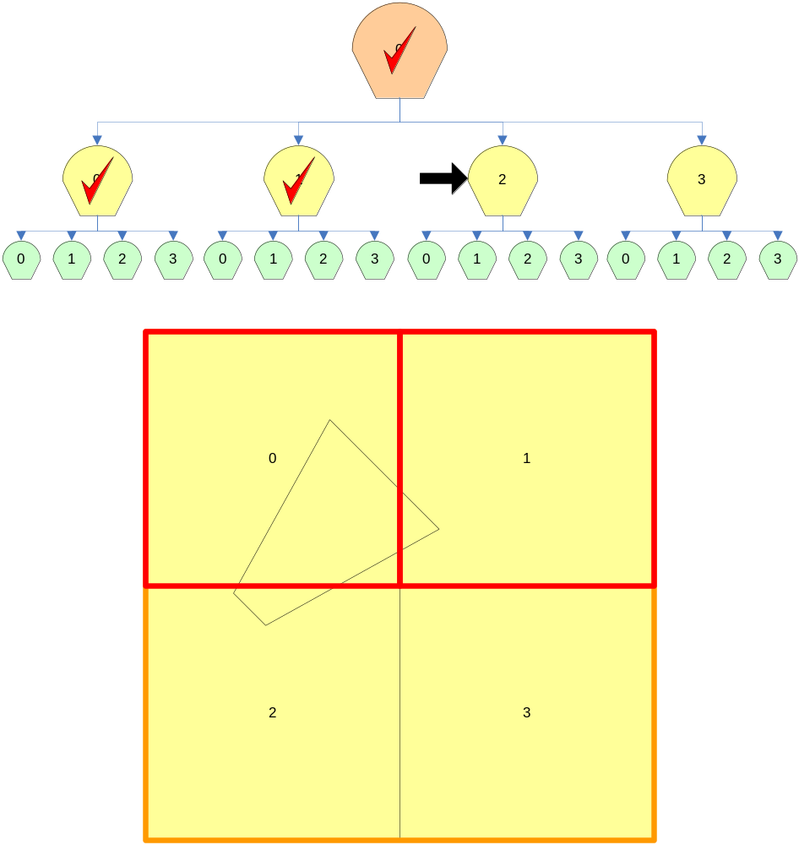
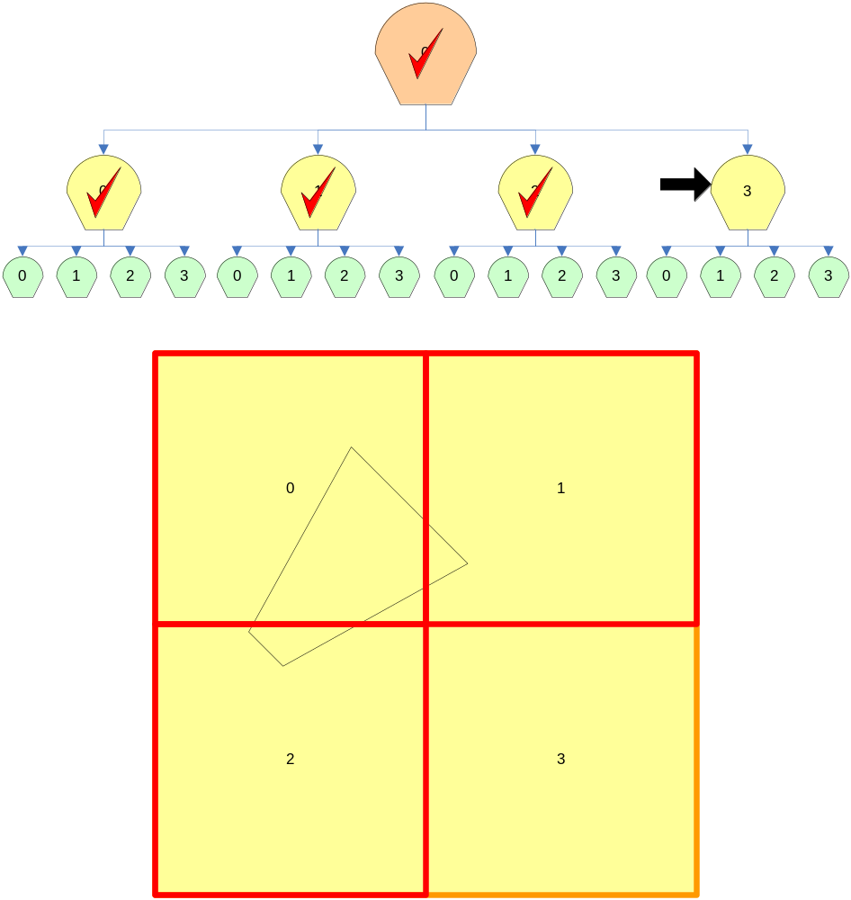
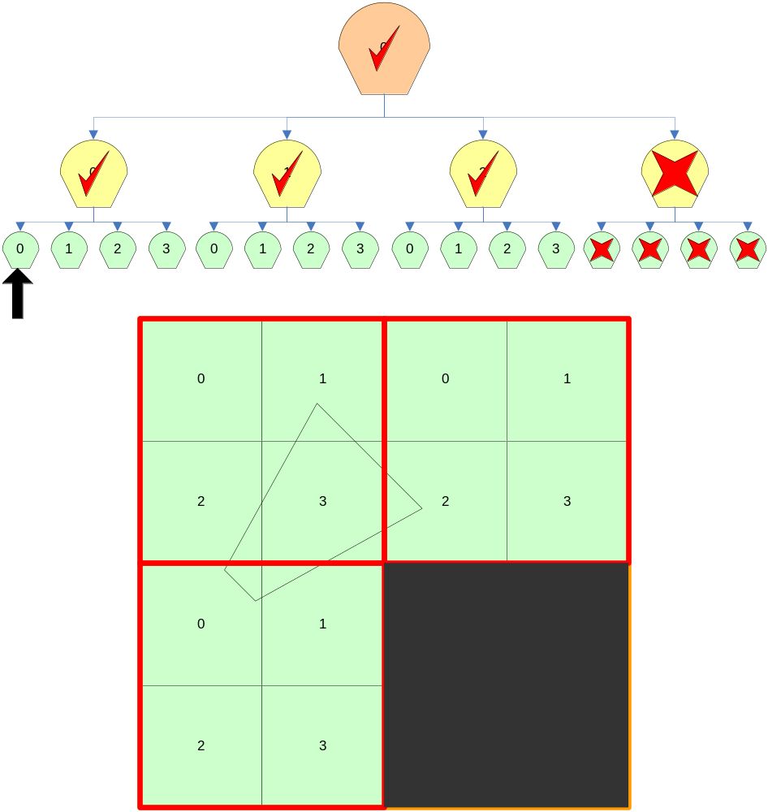
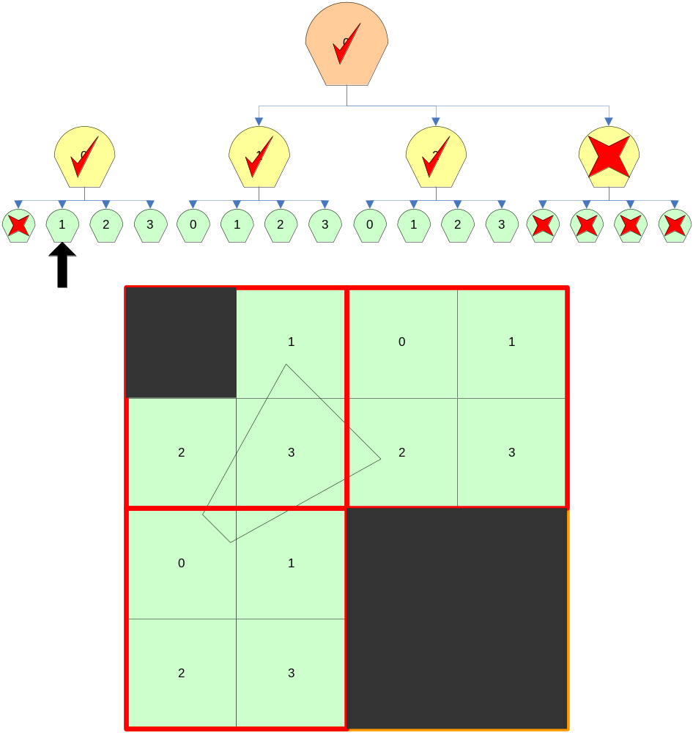
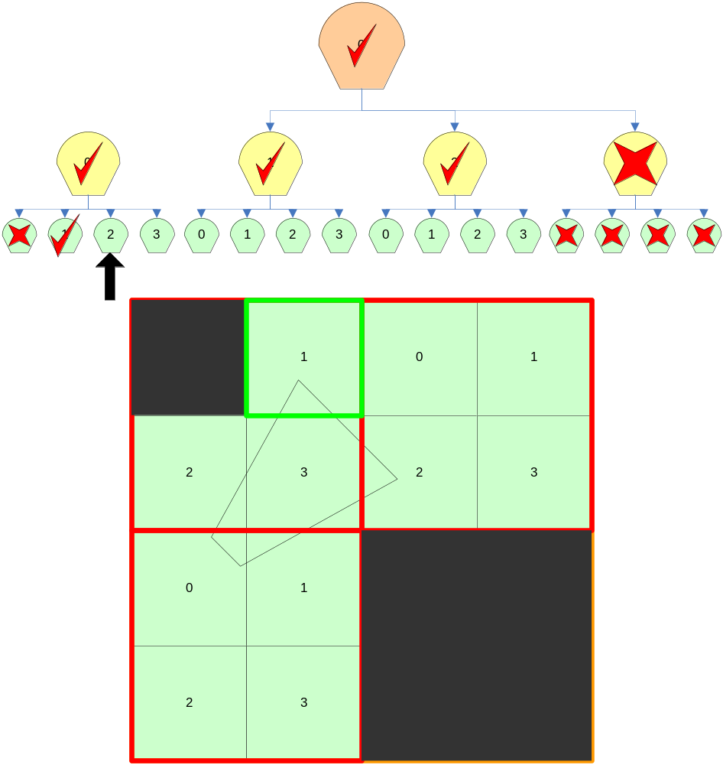
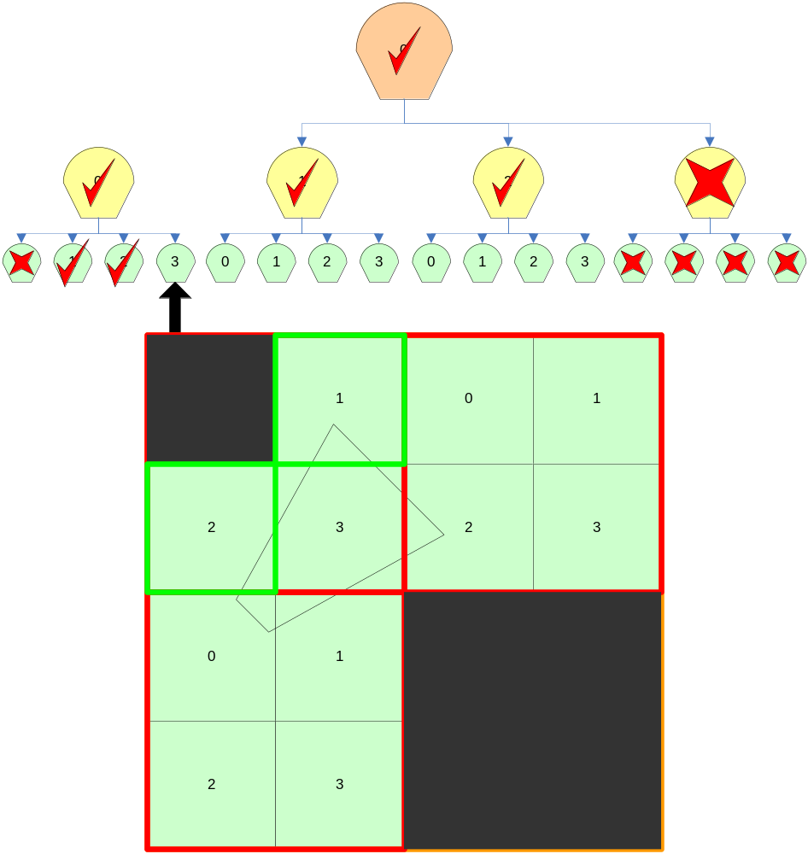
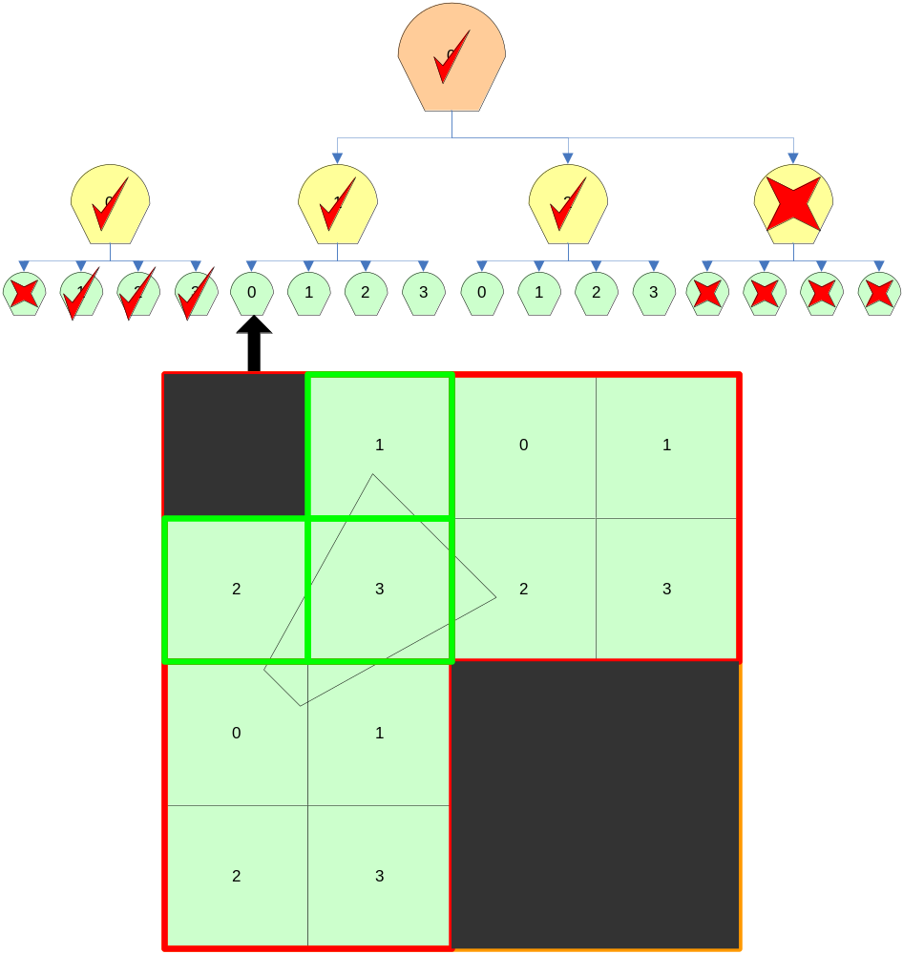
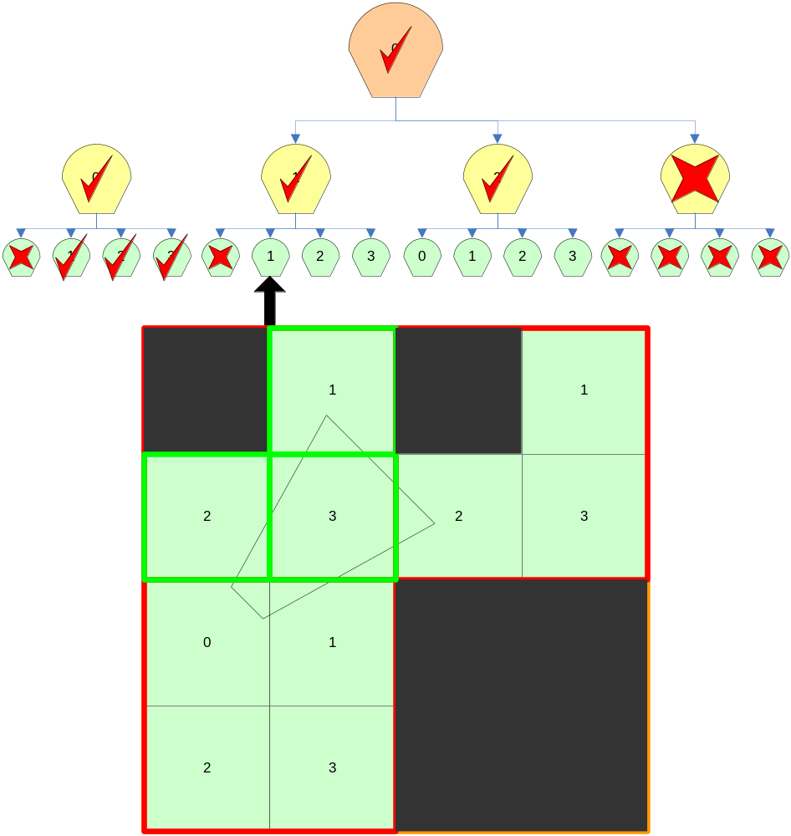
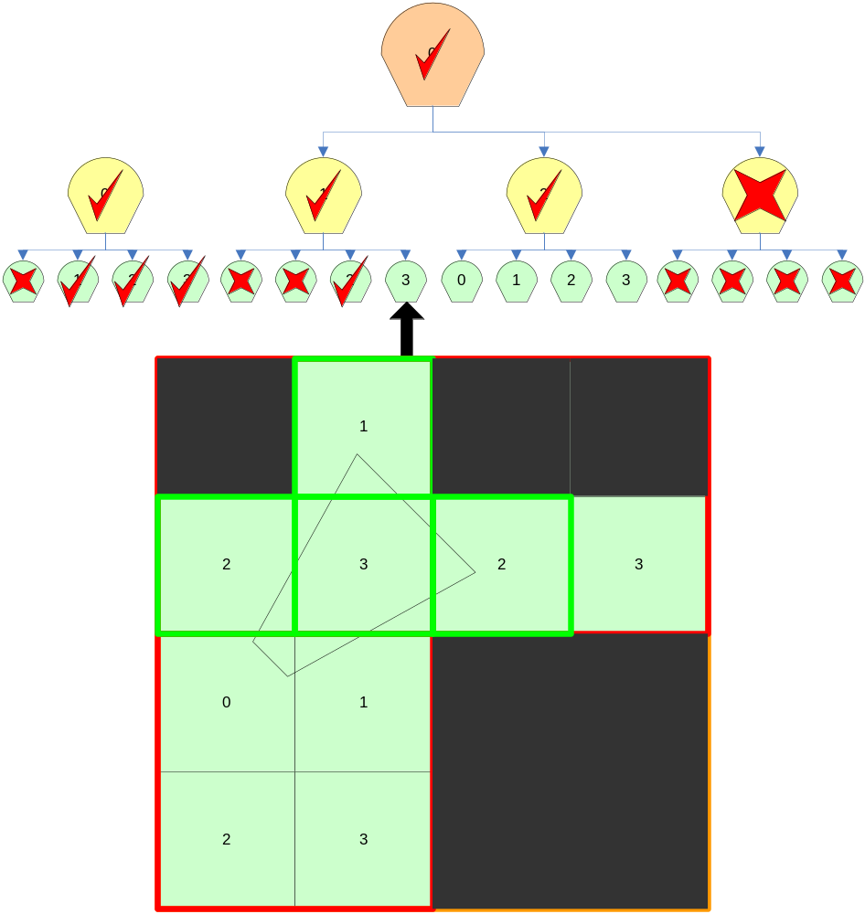
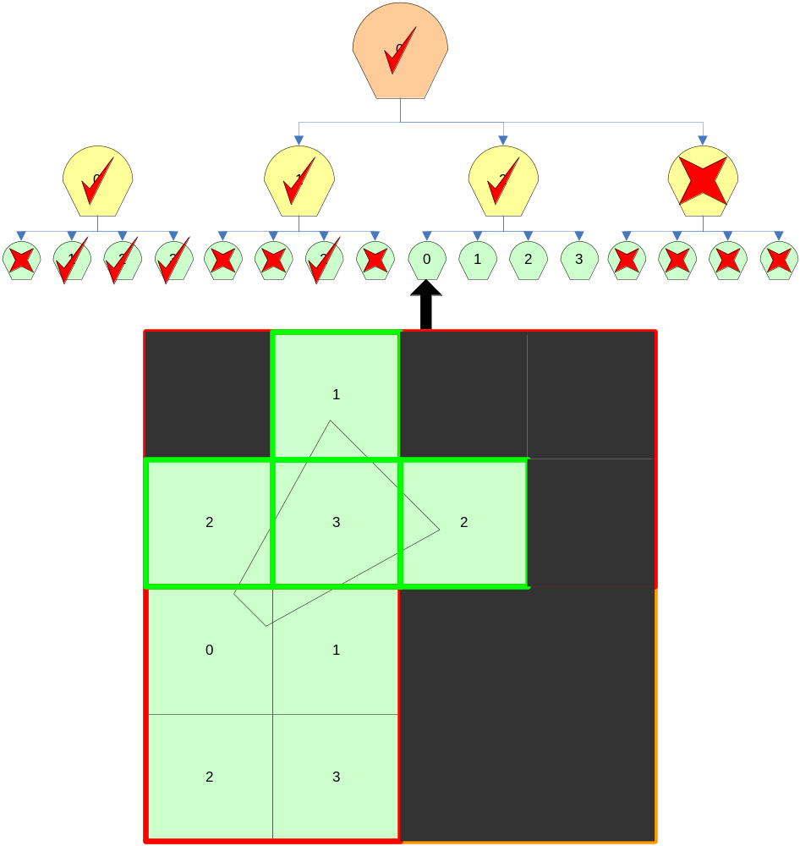

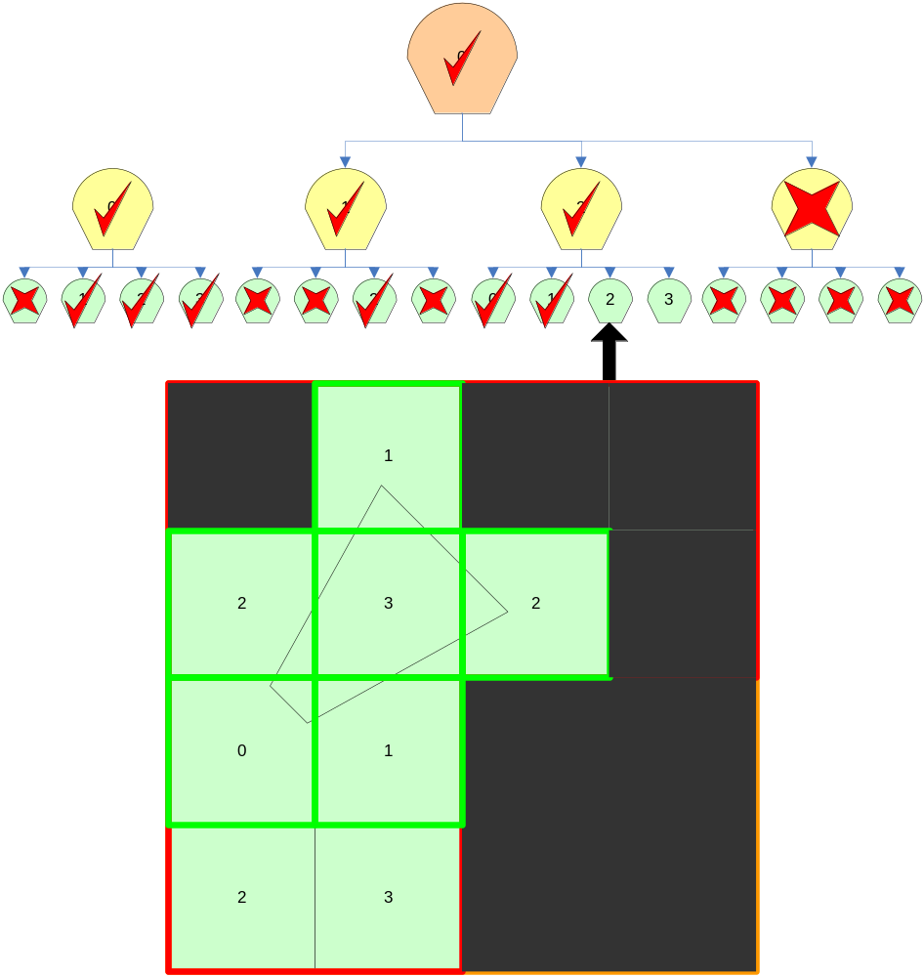
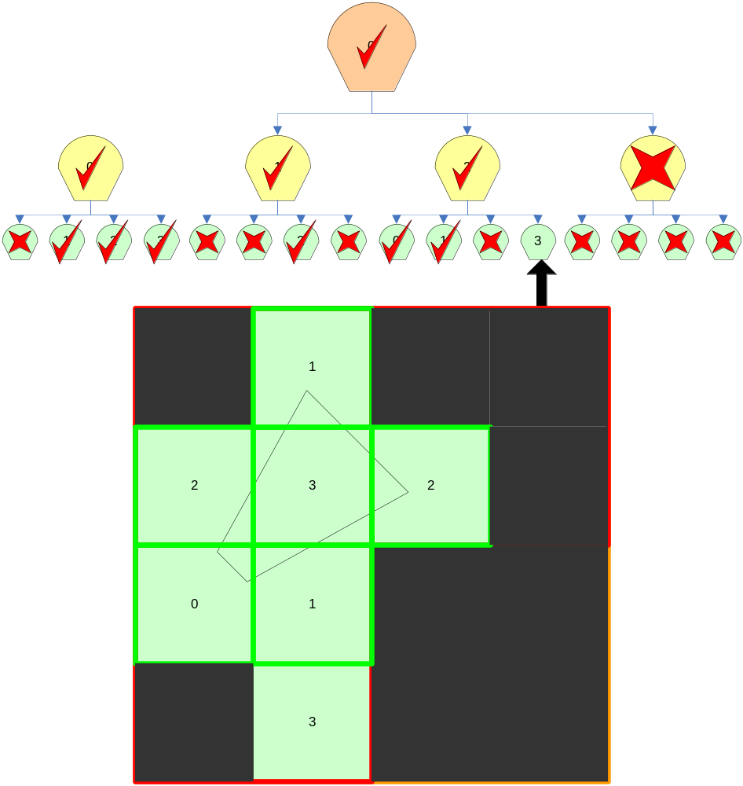
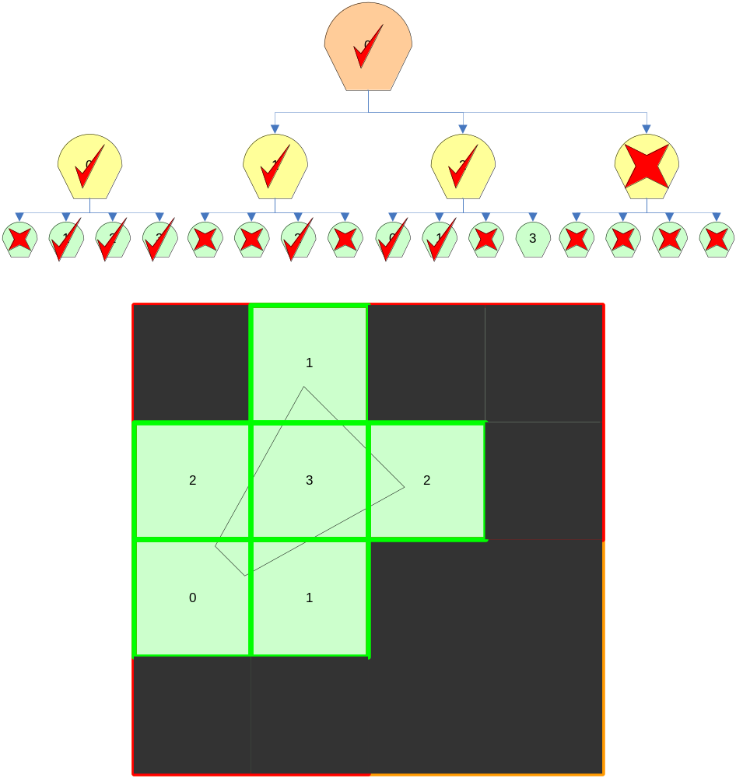
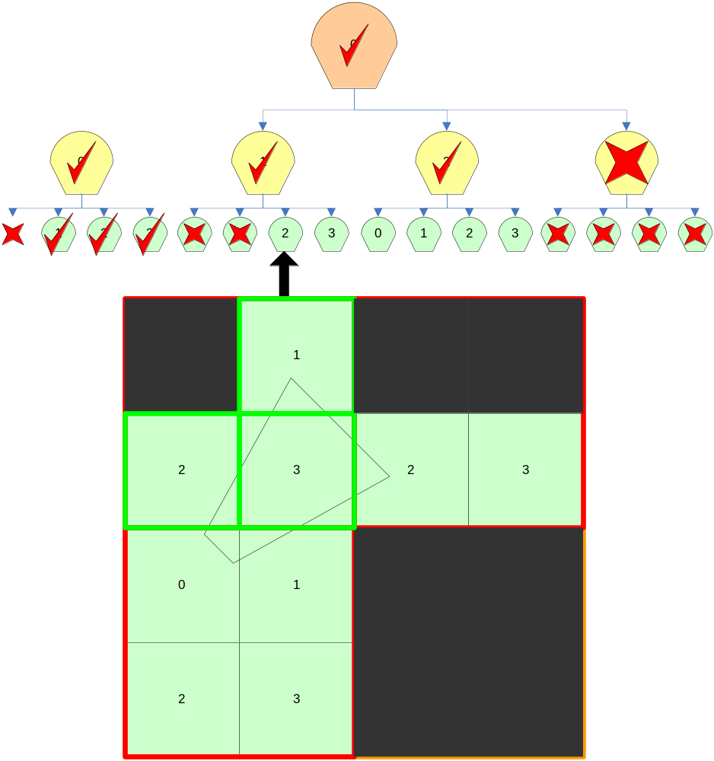
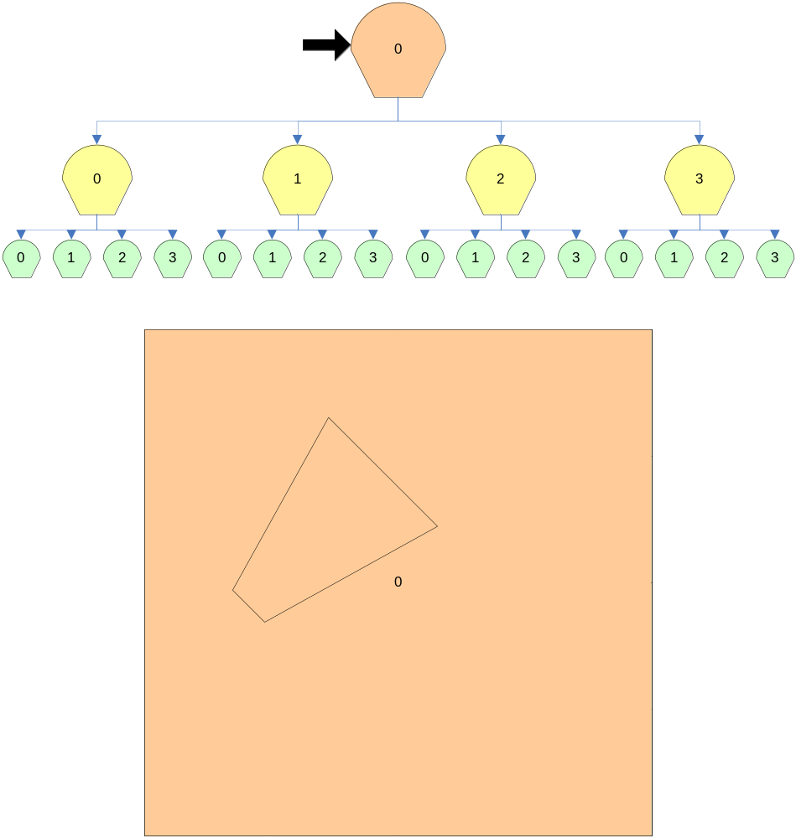
Culling using BVHs

Slide 24
Culling using BVHs
With BVHs we can increase performance by doing a preorder traversal to do the culling
Start at the root node and for every iteration of the traversal, test the BV against the frustum
  If the node’s BV is outside the frustum that branch of the tree is pruned
  If the node’s BV is totally inside the frustum, that branch’s leaves are sent to be rendered
  If the node’s BV is partly inside the frustum, process the node’s children
  If a leaf node intersects then its geometry is rendered

Slide 25
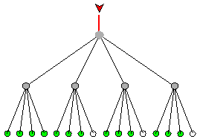
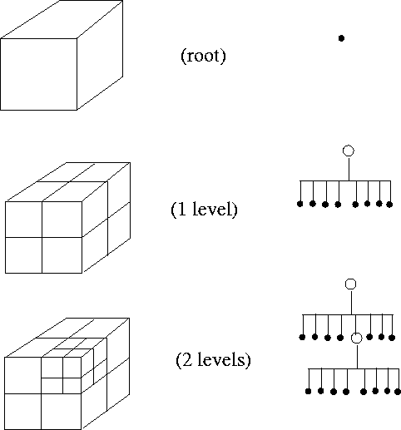
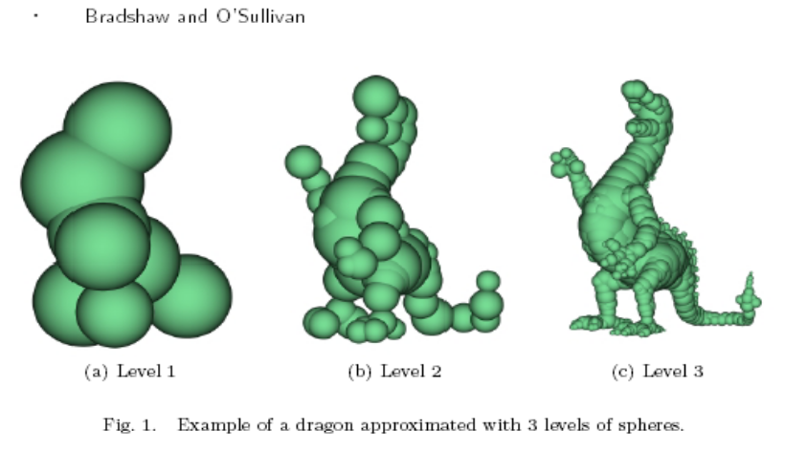
Bounding Volume Hierarchy Types
Quad Tree Oct Tree
  Sphere Tree

Slide 26
BVH Demo
6DOP Demo
18DOP Demo

Slide 27
Bounding Volume Definitions

Slide 28
Axis-aligned Bounding Box (AABB)‏
It’s a box whose face normals are the same as the cardinal axis
Often described as two extreme points:
  Min.xyz and a Max.xyz
Max
Min

Slide 29
Axis-aligned Bounding Box
struct AABB
{
Vector3 min, max;
};
Max
Min

Slide 30
AABB,OBB and k-DOP intersection

Slide 31
AABB/AABB collision detection
For AABB/AABB collision we are just going to check for overlap across each axis
AABBtoAABB(A, B)‏
  For each Axis (x, y, z)‏
    If( A_{a}^{min} > B_{a}^{max} or B_{a}^{min} > A_{a}^{max} )‏
      Return NOT TOUCHING
  Return TOUCHING
  This should be done in a loop.

Slide 32
Bounding Volume Creation

Slide 33
AABB Creation
To create a AABB take the min and max values from all the vertices along each axis
  (Xmin, Ymin, Zmin) (Xmax, Ymax, Zmax)‏

Slide 34
Sphere Creation
First create a AABB with the vertices you are trying to create a sphere for
Use the center of the box as the spheres center and the distance from the center to the corner as the radius
  Fast but is a poor fit
You can improve this by doing another quick pass by finding the vertex that is furthest away from the center and using that distance as the radius

Slide 35
Sphere and AABB motion

Slide 36
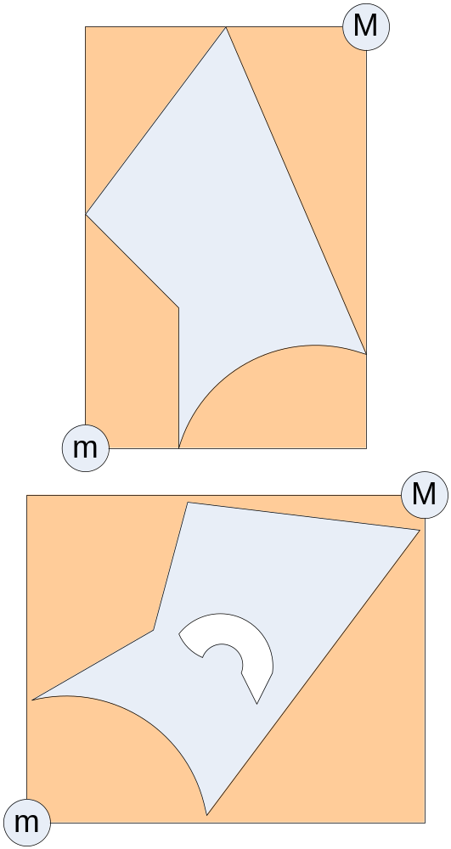
AABB motion
Translating a AABB is very simple
  Take your translation vector and add it to the min and max vectors of the AABB
  Max += move; Min +=move;
Rotating an object forces the AABB to have to be recalculated

Slide 37
Sphere motion
Simply add the translation vector to the center
Rotation doesn’t matter since the rotated object will still be inside the sphere

Slide 38
BVH Generation

Slide 39
BVH generation (Top Down)‏
Create a root node and generate a BV that contains all the triangles
Split the node into N children
  Give some triangles to each of the children
Recurse for each child, until
  Triangle count is down to the right size
  BV volume is down to the right size
  or tree depth is hit
Note: the BVs of the children might overlap

Slide 40
How do we split into TWO children?
For AABB and Sphere we find the largest axis (x, y, z) using the triangles in the current node
  Note: for a sphere you would have to re-project the triangles against the axis
Use the triangles centroids to sort each triangle by the “split axis”
  i.e. If the split axis was the X-axis then you would sort by the centroid.x

Slide 41
How do we split into two children?
Split the triangles into each child node:
  Splitting them by the median will get a balanced tree
    Median = middle of the total bounding volume
  Splitting them by the mean will get a deeper tree but tighter fitting BVs
    Mean = average of all centroids

Slide 42
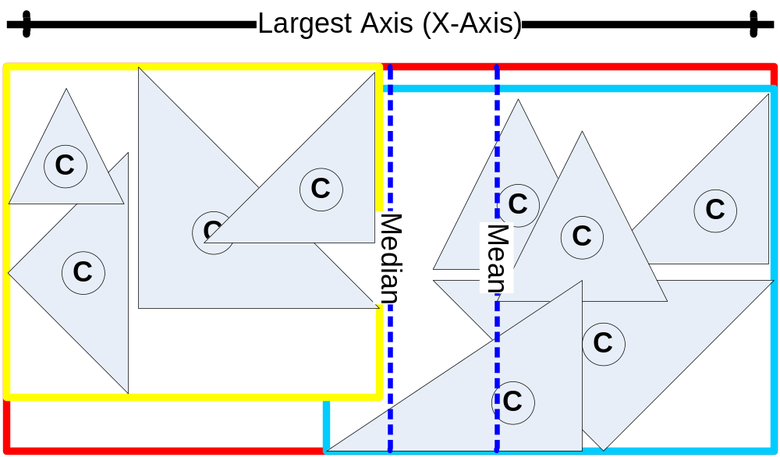
How do we split into two children?

Slide 43
Things to consider
“Loose” trees eliminate triangle splitting
Balanced Trees yield good search times
The more children a node has the shallower the tree, but there is more work to be done per ply
Shallow trees reduce cache misses and cut down on memory foot prints of the node and BVs

Slide 44
Conclusion
Defined the difference between different spatial systems
  SPH Spatial Partition Hierarchies
  BVH Bounding Volume Hierarchies
Discussed creation, motion and collision detection of some different bounding volumes
Went through the steps on creating a BVH

Slide 45
k-DOPs

Slide 46
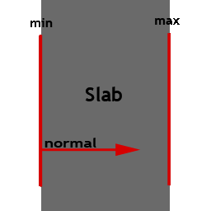
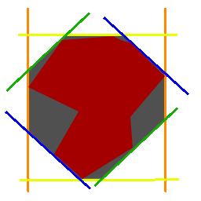
k-DOP Discrete Oriented Polytope
A k-DOP is defined by k/2 Slabs
A Slab is defined by a normal and two scalars^{(min/max)‏}
  A Slab describes the space between two parallel planes
  All k-DOPs in the system use the same set of normals for their slabs
The intersection of all k/2 Slabs defines the k-DOP
  This would make a AABB a 6-DOP

Slide 47
k-DOP Discrete Oriented Polytope
struct Slab
{
float min, max;
};
struct kDOP
{
static Vector3 normals[KDIV2];
Slab slabs[KDIV2];
};
3D Demo of a k-DOP (18 DOP)‏

Slide 48
AABB/AABB detection
For AABB/AABB collision detection we are just going to check for overlap across each axis
AABBtoAABB(A, B)‏
  For each Axis (x, y, z)‏
    If( A_{a}^{min} > B_{a}^{max} or B_{a}^{min} > A_{a}^{max} )‏
      Return NOT TOUCHING
  Return TOUCHING

Slide 49
k-DOP/k-DOP detection
For k-DOP/k-DOP intersection we are going to check for any slabs that overlap stuff
KDOPtoKDOP(A, B)‏
  For each Slab (1…k/2)‏
    If( A_{s}^{min} > B_{s}^{max} or B_{s}^{min} > A_{s}^{max} )‏
      Return NOT TOUCHING
  Return TOUCHING

Slide 50
AABB and k-DOP Creation
To create a AABB take the min and max values from all the vertices along each axis
  (Xmin, Ymin, Zmin) (Xmax, Ymax, Zmax)‏
To create a k-DOP project all the vertices with the normal of each Slab storing the min and max values
  These will be the tightest fitting min/max for that Slab

Slide 51
AABB motion
Translating a AABB is very simple
  Take your translation vector and add it to the min and max vectors of the AABB
  Max += move; Min +=move;
Rotating an object forces the AABB to have to be recalculated

Slide 52
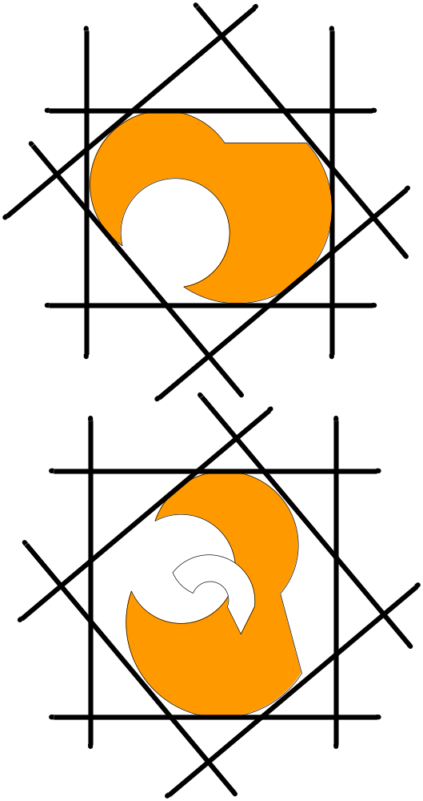
K-DOP motion
To translate a k-DOP all you need it to take the dot product of the translation vector with each slab’s normal and add that to that slab’s min/max value.
  Slab.max += Slab.normal DOT move;
  Slab.min += Slab.normal DOT move;
Rotating an object forces the k-DOP to have to be recalculated

Slide 53
How do we split into two children?
For a k-DOP the algorithm is the same, except we need to find the biggest Slab
Use the triangles centroid to sort by the biggest slab
  i.e. If Slab[0] was the biggest, sort by Slab[0].normal DOT triangle.centroid
Split the triangles into each child node by:
  Splitting them by the median (middle) and get a balanced tree
  Splitting them by the mean (average) and get a deeper tree but tighter fitting BVs

